Slide 1

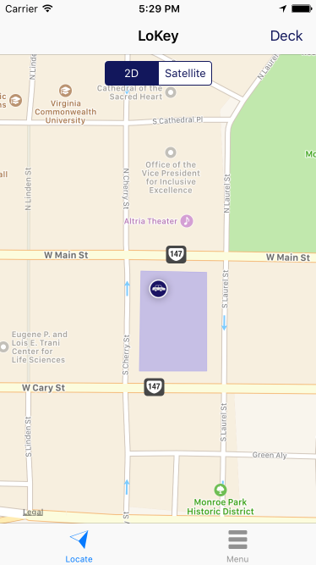
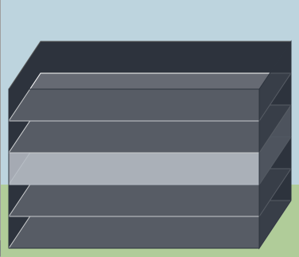
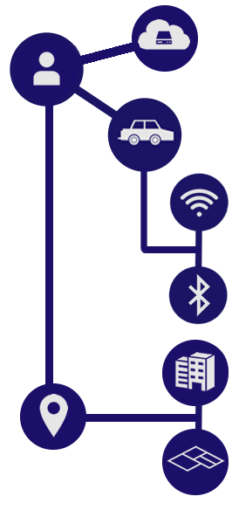
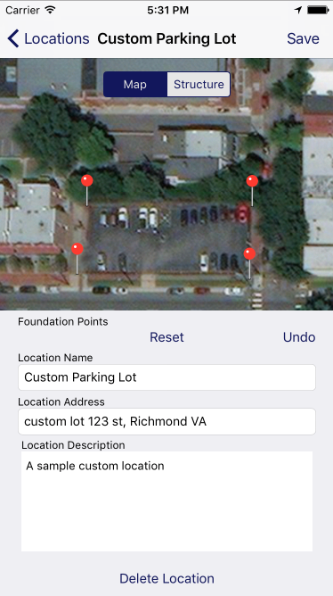
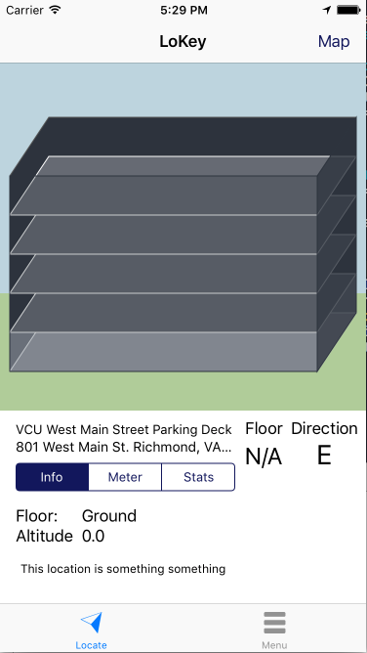





Automatic Parking Application
CMSC 316 | Team members: Corey Gates, Huy Nguyen, John Steiner, | Sponsor: Eyuphan Bulut
Concept
A mobile utility application that tracks users’ devices when in proximity to a tracked device.
This application recognizes parking locations, parking altitude and relevant cardinal positions. Allowing guidance back to their vehicle.
Components
Application utilizes instrument data and maintains an active “state” of the user.
Location Recognition
Floor Approximation & Guidance
User
Custom preferences such as setting a trackable device, along with platform credentials
Features
Records user’s vehicle location
Identifies user’s current location
Provide guidance back to vehicle
Location recognition (Geofencing)
Altitude approximation (Floor Level)
Activity analysis (Motion)
Platform Sync (State persistence)
Crowdsourcing (Parking Data)
Device
Identified via a connection and contains position, altitude, and location details.
Use Cases
Expansion
Internet of Things (IOT)
Let the location recognize the device by configuring the phone or car to act as a BLE beacon. With this technology the location can recognize the device, and sync back to the platform. Such an expansion would reduce the resources required on the user’s device.
Commercialization
Allow for businesses to geofence their parking lot. Allowing demand prediction, suggested availability, and paperless restriction.
Connection
WIFI or Bluetooth audio, can be linked to devices or locations
Street Parking
Standard function. Last known coordinate is recorded as the car’s position. User can use map as reference, or have the app provide directions back to vehicle.
Location
A physical location, identified by a connection or presence inside a geo-fence. Is linked to a structure.
Public Garage
Advanced function. User commutes to his daily parking garage, parks at floor three, then walks to work place. When he returns to the garage, app will show which floor his vehicle is parked on, and cardinal position if available.
Structure
Provides a floor plan of buildings such as parking garages, indicating floor heights and allowing floor identification and visual model generation
Custom Location
Advanced function. User can add a private location. If set to be public, other users will receive the location when in the region. This allows for crowdsourcing of parking locations in new cities.

